Slide 1
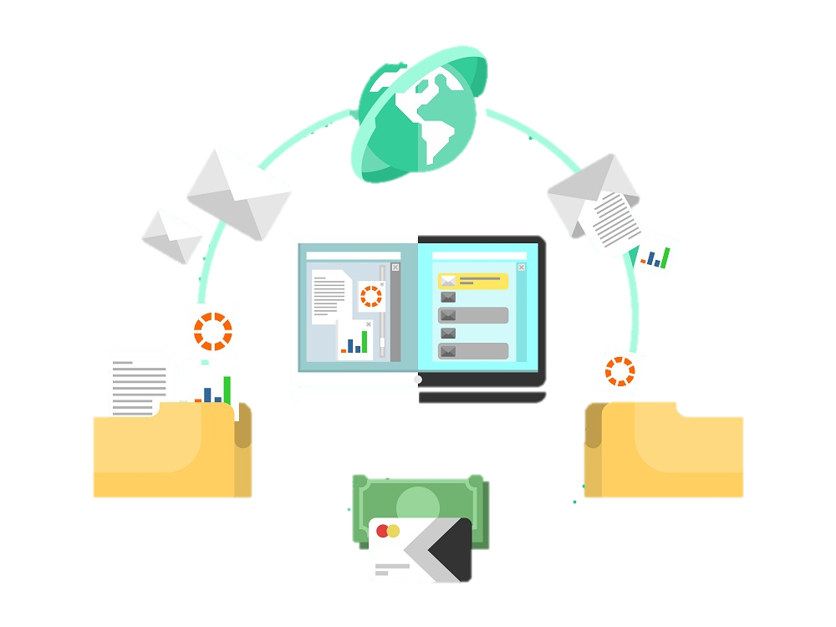
MEASURING OBSERVABLE INFLUENCE
AND IMPACT OF
SCIENTIFIC RESEARCH
BEYOND ACADEMIA
TEAM: ABRACA-DATA
HONGHUI WANG (301378426)
CHHAVI VERMA (301371249)
SHRAY KHANNA (301367221)

Slide 2
GOAL and MOTIVATION
SCHEDULE
PROGRESS
CHALLENGES
NEXT STEPS
AGENDA

Slide 3
OVERVIEW

Slide 4







GOAL
DOWNSTREAM DOCUMENTS
IMPACT
APPLICATIONS
RESEARCH WORK
PAPER
PAPER
PAPER
PAPER
CLINIC
WEBSITES
PAPER
PAPER
MEDICATION
HISTORY
PAPER
PAPER
PAPER
PAPER
GUIDELINES
HANDBOOK
Notes:
APPLICATIONS CLINICAL WEBSITES, HANDBOOKS, PDFS AN

Slide 5
MOTIVATION
Checking the impact of research publication in Healthcare for future implementation.
Make healthcare research more impactful and beneficial to people.
Help researchers understand the real world impacts of healthcare publications.
Notes:
Goal and motivation target type pc

Slide 6
SCHEDULE

Slide 7
FEB 18
MAR 11
MAR 16
FEB 24
MAR 4
MAR 20
MAR 27
APR 2
APR 4
APR 8
APR 14
FINAL REPORT
+
VIDEO
EDA ON
CLIENT’S DATA
ANALYZING REF IN DATABASE
PROPOSAL
PRESENTATION
VISUALIZATION
DATA COLLECTION
+
SCRAPPING
EXTRACTING REFERENCES USING NLP
FINAL ANALYSIS
POSTER PRESENTATION
DATABASE COMPLETION
+
CLEANING

Slide 8
PROGRESS

Slide 9
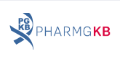

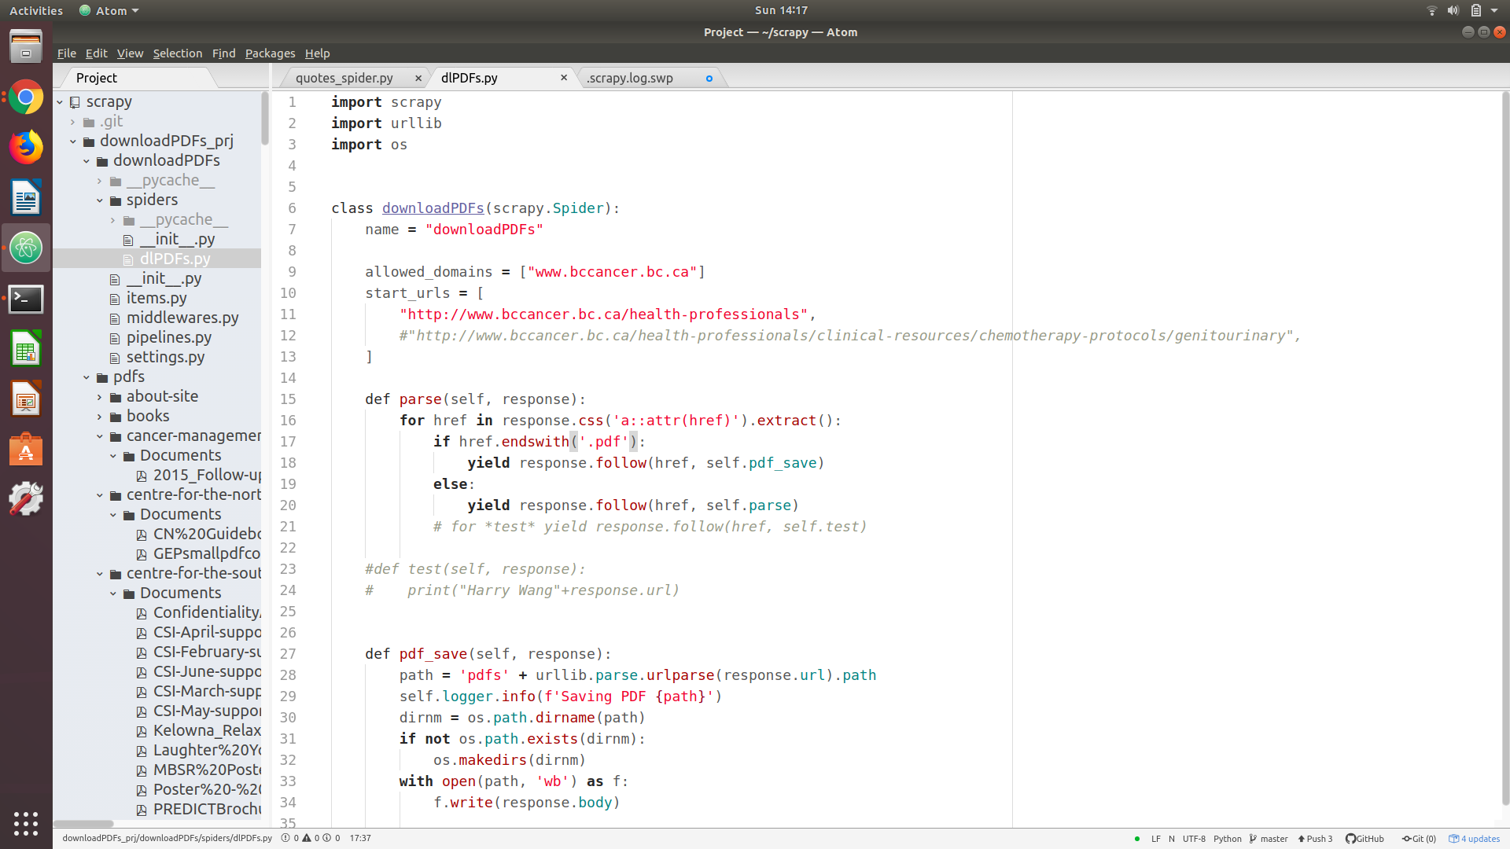
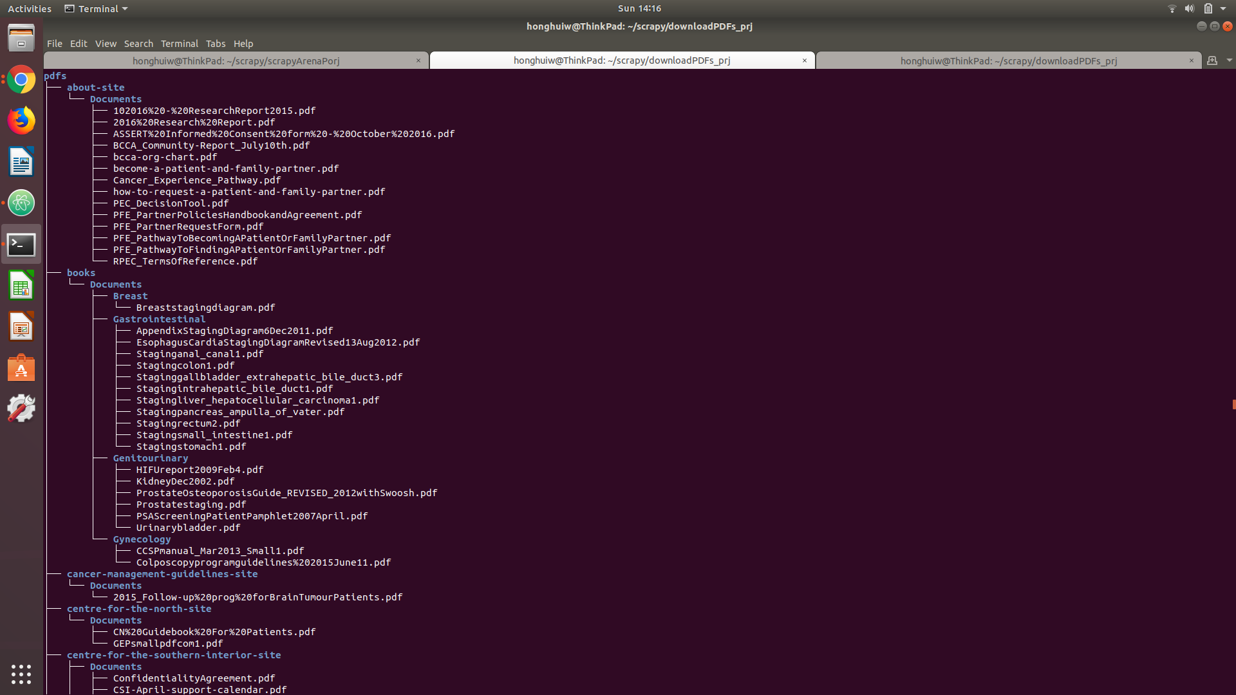
DATA ACQUISITION
DATA FROM 5 DIFFERENT SOURCES SHOWN BELOW:
MANUALLY DOWNLOADING UNSTRUCTURED DATA.
USING TOOLS LEARNED TO SCRAP THE DOCUMENTS FROM THE GIVEN WEBSITES.

Slide 10
CHALLENGES

Slide 11
FIRST GLANCE AT THE “DOWNSTREAM DOCUMENTS”
URLs
URLs
PDFs
URLs
PDFs
URLs
PDFs
IS IT THIS SIMPLE TO SOLVE???
Notes:
AT A FIRST GLANCE, WE SEE URLS WHICH CONTAIN PDFS AND LINKS TO OTHER DB FOR DOWNSTREAM DOCUMENTS, BUT IT IS NOT AS SIMPLE AS IT LOOKS…. IT’S LIKE THE MOVIE INCEPTION!!!!!

Slide 12

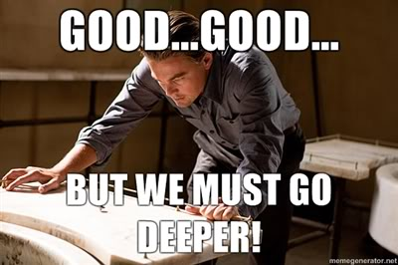
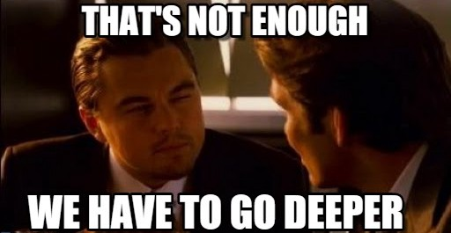
NO

Slide 13
OUR CHALLENGE
URLs
URLs
URLs, PDFS, dB API
AND HANDBOOKS
URL
PDFs
dB
PARSING & QUERIES
URL
PDF
dB
URL
PDF
dB
PDF
REFERENCES AND IMPLEMENTATIONS TO THE PAPERS
Notes:
THE BIGGEST CHALLENGE IS TO GET DOWNSTREAM DOCUMENTS BY SEARCHING URL AND PDF. THE WEBSITES HAVE A LAYERED APPROACH BECAUSE OF WHICH IT FORMS A TREE LIKE STRUCTURE FOR DOCUMENTS.
TRADITIONALLY, THE METHOD TO GET TO THIS LAYERED APPROACH IS BY GOING TO URL. WE ARE TRYING TO APPROACH THIS BY GIVING URL AND PDF BY GENERATING SOME QUERY.
CRAWLING IS A TEDIOUS TASK FOR EVERY LINK AS THE HTML STRUCTURE IS COMPLETELY DIFFERENT.
DATA IS NOT CONSISTENT AND REFERENCE FORMATS ARE DIFFERENT EVEN IN THE SAME WEBSITE.

Slide 14
FUTURE WORK
NLP
PUBLISHED PAPERS DATA
IMPACT REPORT
REFERENCES
EXTRACTING REFERENCES TO BUILD THE DATABASE
BUILD LABELLED TRAINING DATA FROM PAPERS WHO HAVE DOIs FOR NLP MODEL.
USING NLP TO GET CORRECT KEYWORDS
EDA ON GENOME BC’s DATA
GETTING IMPACTS FROM EACH PUBLICATION USING ANALYSIS
VISUALIZATION USING TABLEAU
AUTOMATE SCRAPING PROCESS TO TEST
Notes:
Nlp,automation,visualization

Slide 15
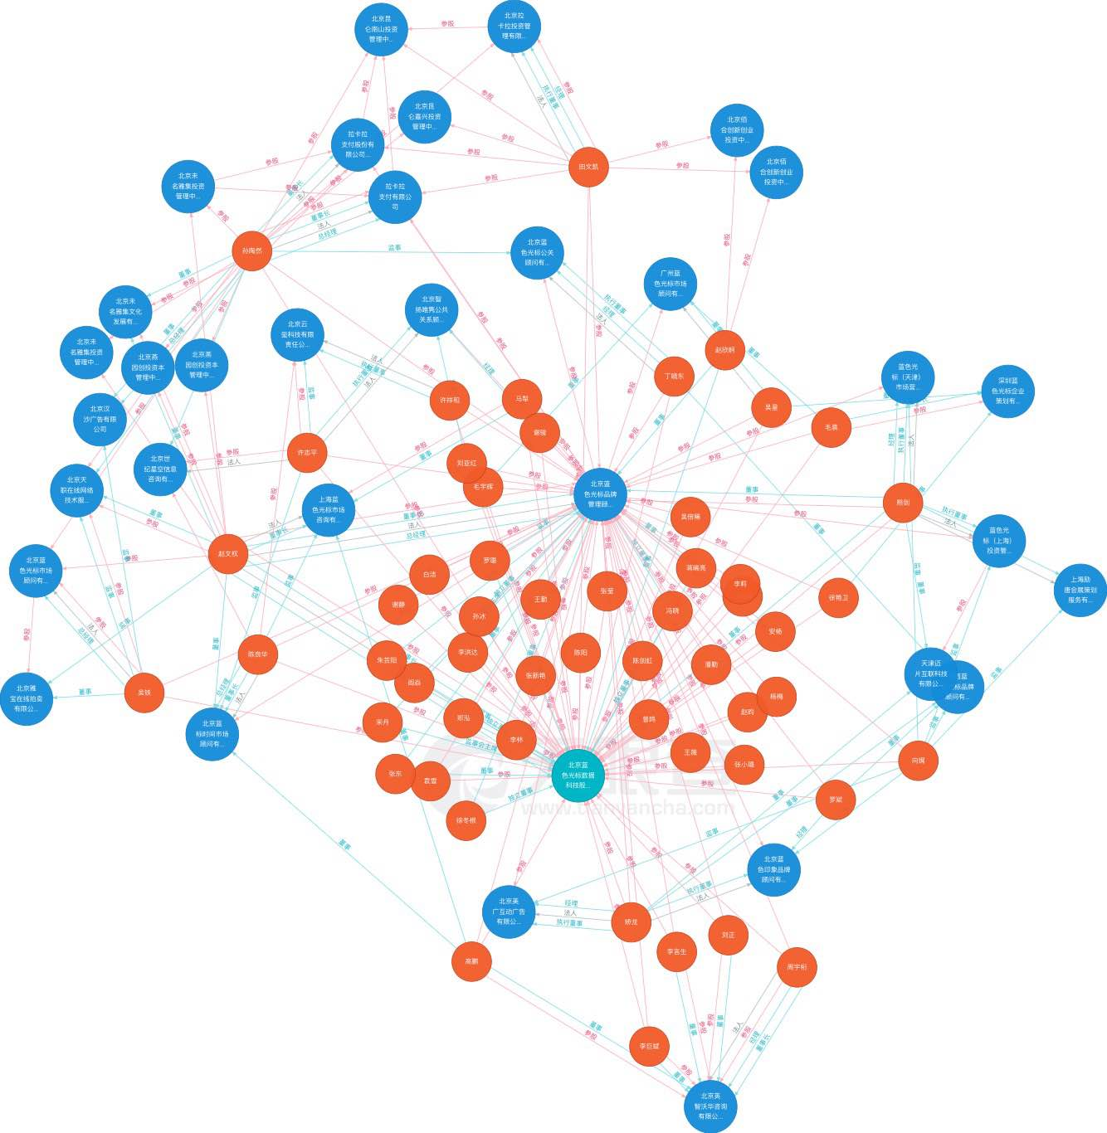
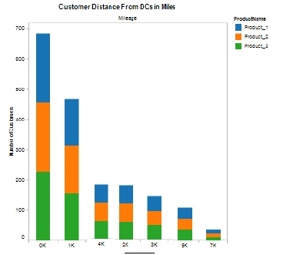
OUR GOAL
Notes:
TARGET, EVERY PUBLISHED ARTICLE IS CONNECTED TO THE DOWNSTREAM DOCUMENT WHERE THE METHOD OF RESEARCH IS OPTED, SHOWCASING THE IMPACT OF EACH PUBLICATION.

Slide 16
QUESTIONS?
Notes:
questions

